Slide 1
System Analysis & Design
Use Case Diagram
Source
Mastering UML with Rational Rose 2002

Slide 2

Use Case Diagram
Use cases represent system functionality, the requirements of the system from the user's perspective
Use cases just focus on automated processes
Use case diagrams show the interactions between
  Use cases: what the system should do, and
  Actors: anyone or anything that interacts with the system (Individual, group, company,…)
Source
Mastering UML with Rational Rose 2002
Notes:
There is not a one-to-one relationship between business use cases and use cases

Slide 3
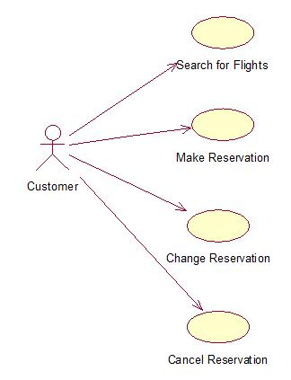
Example
Source
Mastering UML with Rational Rose 2002

Slide 4
Elements of Use Case Diagram
Actor
An actor is anyone or anything that is outside the system’s scope but interacts with it (Individual, group, company,…)
There are three types of actors:
  Users of the system
    physical person, or a user who will be directly using the system
  Other systems that will interact with the system being built
  Time
    Time becomes an actor when the passing of a certain amount of time triggers some event in the system (out of control)
Source
Mastering UML with Rational Rose 2002

Slide 5
Elements of Use Case Diagram
Use Case
It is the functionality the system will provide a value to the end user
Use cases are an implementation-independent:
  High-level view of what the user expects from the system
  Focus on what the system should do, not how the system will do it
A typical system will have somewhere between 20 and 70 use cases
The use cases should be named in user terms, not technical terms, and should be meaningful to the customer
Source
Mastering UML with Rational Rose 2002

Slide 6
Elements of Use Case Diagram
Use Case cont.
So, when you have the final list of use cases, how do you know if you've found them all?
Is each functional requirement in at least one use case? If a requirement is not in a use case, it will not be implemented.
Have you considered how each end user will be using the system?
- What information will each end user be providing for the system?
- What information will each end user be receiving from the system?
- Have you considered maintenance issues? Someone will need to start the system and shut it down.
- Have you identified all of the external systems with which the system will need to interact?
- What information will each external system be providing to the system and receiving from the system?
Source
Mastering UML with Rational Rose 2002

Slide 7
Elements of Use Case Diagram
Use Case: Flow of Events
To actually build the system, though, you'll need more specific details. These details are written as the flow of events
The purpose of the flow of events is to document the flow of logic through the use case
Although it is detailed, the flow of events is still implementation-independent
Source
Mastering UML with Rational Rose 2002

Slide 8
Elements of Use Case Diagram
Use Case: Flow of Events cont.
This document will describe in detail what the user of the system will do and what the system itself will do
Notice the pattern in the flow of events:
  The user does something, then
  The system does something in response,
  Then the user does something, then the system responds, and so on
Source
Mastering UML with Rational Rose 2002

Slide 9
Elements of Use Case Diagram
Use Case: Flow of Events cont.
It includes:
  *A brief description: Each use case should include a short description that explains what the use case will do
  Preconditions: list any conditions that have to be met before the use case can start at all. For example, the precondition for one use case may be that another use case has run
  *Flow of events
  Post conditions: are conditions that must always be true after the use case has finished executing. Like preconditions, post conditions can be used to add information about the order in which the use cases are run
Source
Mastering UML with Rational Rose 2002
Notes:
* Means mandatory

Slide 10
Elements of Use Case Diagram
Use Case: Flow of Events Types
There are three types of flows:
  Primary flow is the "happy day" scenario, or the most frequently used path through the use case
  Alternate flows are deviations from the primary flow that do not suggest an error condition
  Error flows are deviations from the primary or alternate flows that suggest some sort of error condition. Error flows suggest that there is a problem with the system itself
Source
Mastering UML with Rational Rose 2002

Slide 11
Elements of Use Case Diagram
Use Case: Flow of Events Users
There are three primary users of the flow of events:
1- The customers will be reviewing this document to make sure it accurately reflects their expectations
2- The system designers will be using it to create the system design and eventually to build the system
3- The quality assurance team will use the flow of events to create test scripts
The flow of events must give them enough information to understand the sequence of events that needs to occur through the use case
Source
Mastering UML with Rational Rose 2002

Slide 12
Elements of Use Case Diagram
Relationships
The association relationship is used to show the relationship between a use case and an actor
There are two types of relationships between use cases
  Includes relationship
  Extends relationship
  These relationships are used when there is a certain amount of commonality between the use cases
Generalization relationship is the only relationship allowed between actors
Source
Mastering UML with Rational Rose 2002

Slide 13
Elements of Use Case Diagram
Relationships: Association
Association relationship is used to show the relationship between a use case and an actor
Every use case must be initiated by an actor, With the exception of use cases in includes and extends relationships
Source
Mastering UML with Rational Rose 2002

Slide 14
Elements of Use Case Diagram
Relationships: Includes
Includes relationship allows one use case to use the functionality provided by another use case
This relationship can be used in one of two cases:
  First, if two or more use cases have a large piece of functionality that is identical
  The second case where an includes relationship is helpful is a situation in which a single use case has an unusually large amount of functionality
An includes relationship suggests that one use case always uses the functionality provided by another
<<includes>>
Make Reservation
Check Credit
Source
Mastering UML with Rational Rose 2002

Slide 15
Elements of Use Case Diagram
Relationships: Extends
Extends relationship allows one use case the option to extend the functionality provided by another use case
It is very similar to an includes relationship, because in both of these types of relationships, you separate some common functionality into its own use case
<<extends>>
Change Reservation
Check Credit
Source
Mastering UML with Rational Rose 2002

Slide 16
Elements of Use Case Diagram
Abstract Use Case
An abstract use case is one that is not started directly by an actor
Instead, an abstract use case provides some additional functionality that can be used by other use cases
Abstract use cases are the use cases that participate in an includes or extends relationship
Source
Mastering UML with Rational Rose 2002

Slide 17
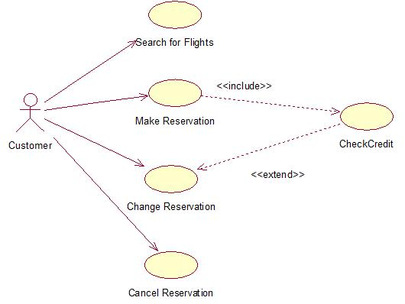
Example
Source
Mastering UML with Rational Rose 2002

Slide 18
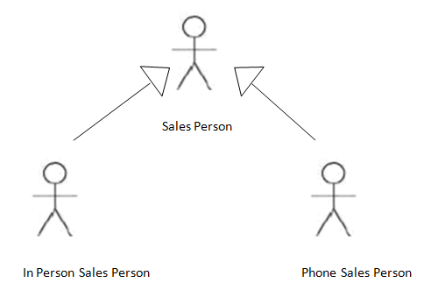
Elements of Use Case Diagram
Relationships: Generalization
Generalization relationship is used to show that several actors
For example, you may have two types of customers. If the type A customers will be initiating some use cases that type B customers will not, it's probably worth including the actor generalizations. If both types of customers use the same use cases, it's probably not necessary to show an actor generalization

Slide 19
Practice
Draw a Use Case Diagram shows the interactions between the use cases and actors of an ATM system:
  The bank's customer initiates a number of use cases: Withdraw Money, Deposit Funds, Transfer Funds, Make Payment, View Balance, and Change PIN.
  The bank officer can also initiate the Change PIN use case.
  The Make Payment use case provides credit card payment information to the credit system.
Source
Mastering UML with Rational Rose 2002

Slide 20
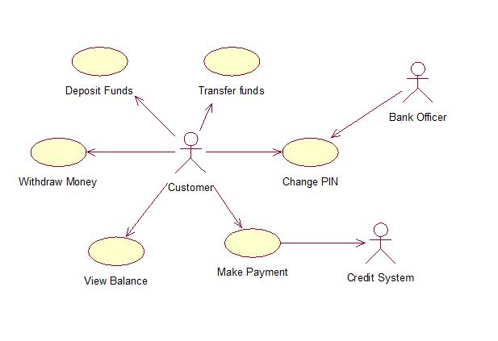
Source
Mastering UML with Rational Rose 2002

Slide 21
Thank You ☺

